Slide 1
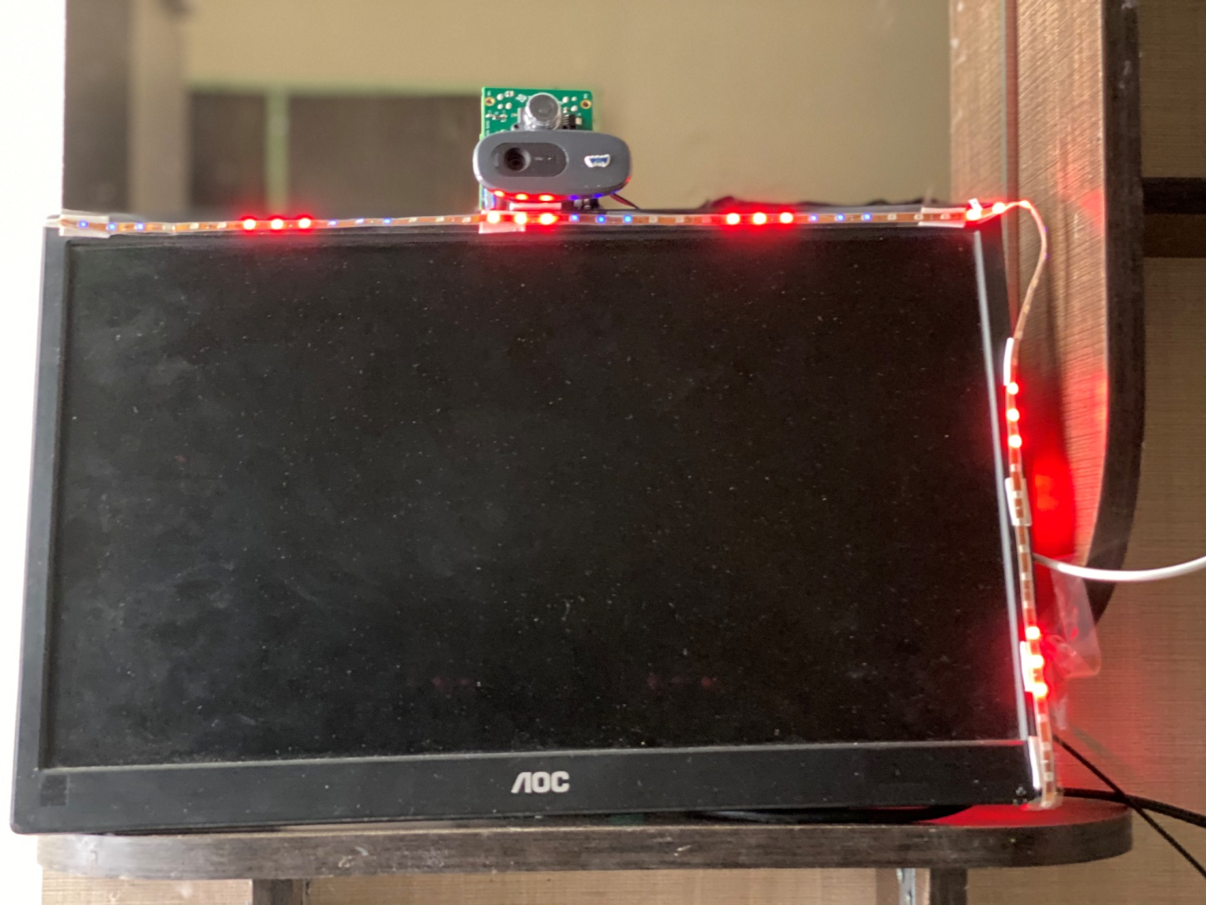

Slide 2
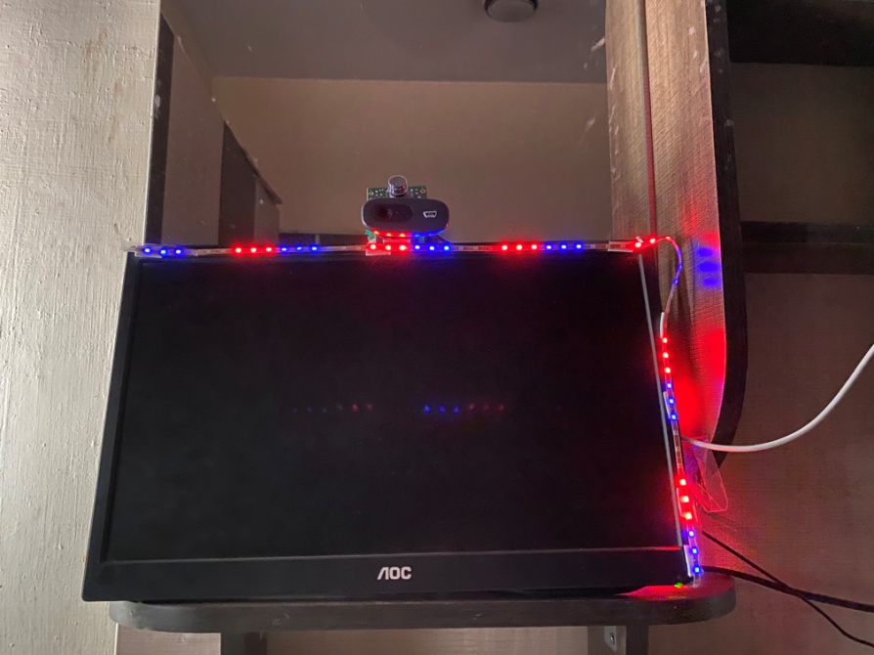

Slide 3
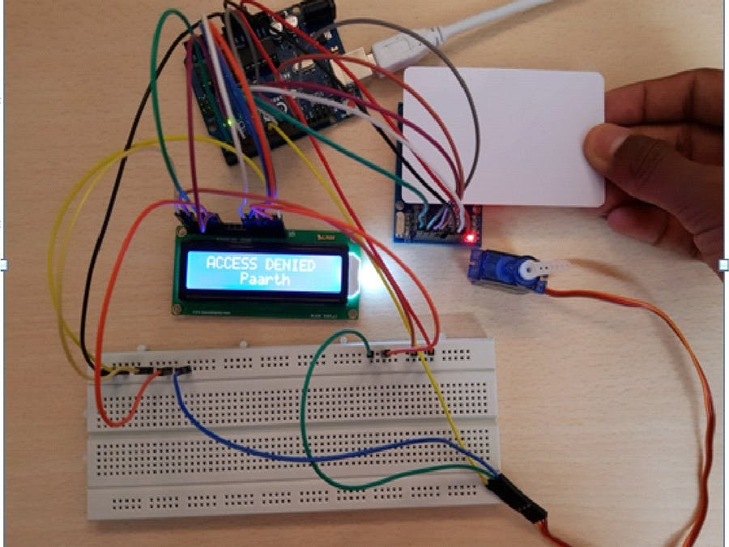

Slide 4

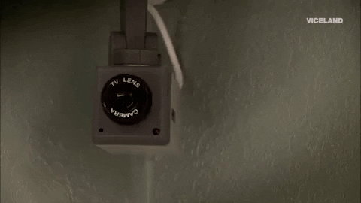

Slide 5

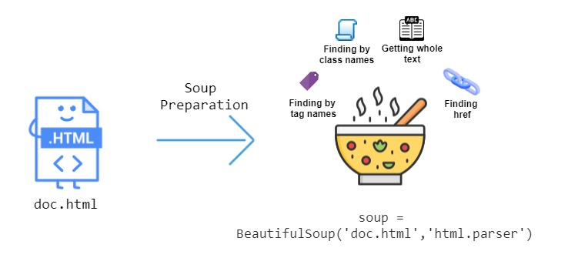
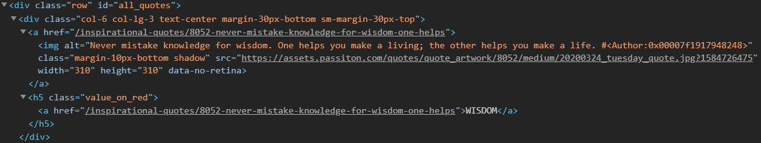

Slide 6
ADVANTAGES OF LLL
MAKING ALL LIBRARIES 24/7 ACCESS
NO JOB WILL BE LOST
MAKING BOTH USER AND LIBRARIAN CONVIENT AND HAPPY.
HIGH SECURITY
MAKING READING A HABIT AMONG YOUNGSTERS .
Books serve to show a man that those original thoughts of his aren’t very new after all

